Slide 1
Chapter 4
Digital Transmission
4.<number>

Slide 2
4-2 ANALOG-TO-DIGITAL CONVERSION
A digital signal is superior to an analog signal because it is more robust to noise and can easily be recovered, corrected and amplified.
Change an analog signal to digital data.
Pulse Code Modulation (PCM)
Delta Modulation (DM)
4.<number>

Slide 3
PCM
PCM consists of three steps to digitize an analog signal:
  Sampling
  Quantization
  Binary encoding
Filter the signal to limit the maximum frequency of the signal as it affects the sampling rate.
Filtering should ensure that we do not distort the signal, i.e. remove high frequency components that affect the signal shape.
4.<number>

Slide 4

Figure 4.21 Components of PCM encoder
4.<number>

Slide 5
Sampling
Analog signal is sampled every T_{S} secs.
T_{s} is referred to as the sampling interval.
f_{s} = 1/T_{s} is called the sampling rate or sampling frequency.
There are 3 sampling methods:
  Ideal - an impulse at each sampling instant
  Natural - a pulse of short width with varying amplitude (using switch)
  Flat top - sample and hold, like natural but with single amplitude value (using circuit)
Pulse amplitude modulation (PAM) and the outcome is a signal with analog (non integer) values
4.<number>

Slide 6

Three different sampling methods for PCM
  - a pulse of short width with varying amplitude
  Ideal - an impulse at each sampling instant
  - sample and hold, like natural but with _{single amplitude value}
4.<number>

Slide 7

Nyquist sampling rate for low-pass and band-pass signals
According to the Nyquist theorem, the sampling rate must be
at least 2 times the highest frequency contained in the signal.
4.<number>

Slide 8

Figure 4.24 Recovery of a sampled sine wave for different sampling rates
a good approximation of the original sine wave
same approximation, but it is redundant and unnecessary
signal does not that looks like the original sine wave.
4.<number>

Slide 9
Example 4.10
A complex low-pass signal has a bandwidth of 200 kHz. What is the minimum sampling rate for this signal?
Solution
The bandwidth of a low-pass signal is between 0 and f, where f is the maximum frequency in the signal.
Therefore, sample this signal at 2 times the highest frequency (200 kHz).
The sampling rate is therefore 400,000 samples per second.
4.<number>

Slide 10
Example 4.11
A complex bandpass signal has a bandwidth of 200 kHz. What is the minimum sampling rate for this signal?
Solution
We cannot find the minimum sampling rate in this case because we do not know where the bandwidth starts or ends. We do not know the maximum frequency in the signal.
4.<number>

Slide 11
Quantization
Sampling results in a series of pulses of varying amplitude values ranging between two limits: a min and a max.
The amplitude values are infinite between the two limits.
We need to map the infinite amplitude values onto a finite set of known values.
This is achieved by dividing the distance between min and max into L zones, each of height Δ.
Δ = (max - min)/L
4.<number>

Slide 12
Quantization Levels
The midpoint of each zone is assigned a value from 0 to L-1 (resulting in L values)
Each sample falling in a zone is then approximated to the value of the midpoint.
Assume we have a voltage signal with amplitutes V_{min}=-20V and V_{max}=+20V.
We want to use L=8 quantization levels.
Zone width Δ = (20 - -20)/8 = 5
The 8 zones are: -20 to -15, -15 to -10, -10 to -5, -5 to 0, 0 to +5, +5 to +10, +10 to +15, +15 to +20
The midpoints are: -17.5, -12.5, -7.5, -2.5, 2.5, 7.5, 12.5, 17.5
4.<number>

Slide 13
Assigning Codes to Zones
Each zone is then assigned a binary code.
The number of bits required to encode the zones, or the number of bits per sample as it is commonly referred to, is obtained as follows:
n_{b} = log₂ L
Given our example, n_{b} = 3
The 8 zone (or level) codes are therefore: 000, 001, 010, 011, 100, 101, 110, and 111
Assigning codes to zones:
  000 will refer to zone -20 to -15
  001 to zone -15 to -10, etc.
4.<number>

Slide 14

Quantization and encoding of a sampled signal
4.<number>

Slide 15
Quantization Error
Coded signal is an approximation of the actual amplitude value.
Quantization error - The difference between actual and coded value (midpoint)
The more zones, the smaller Δ results in smaller errors.
More zones => More bits required to encode the samples => higher bit rate
4.<number>

Slide 16
Quantization Error and SN_{Q}R
The quantization error changes the signal-to-noise ratio of the signal, which in turn reduces the upper limit capacity according to Shannon.
Goal is to keep SN_{Q}R fixed for all sample values.
Two approaches:
  The quantization levels follow a logarithmic curve. Smaller Δ’s at lower amplitudes and larger Δ’s at higher amplitudes.
  Companding: The sample values are compressed at the sender into logarithmic zones, and then expanded at the receiver.
    The zones are fixed in height.
    Companding gives greater weight to strong signals and less weight to weak ones
4.<number>

Slide 17
Bit rate and bandwidth requirements of PCM
The bit rate of a PCM signal can be calculated form the number of bits per sample x the sampling rate
Bit rate = n_{b} x f_{s}
The bandwidth required to transmit this signal depends on the type of line encoding used.
A digitized signal will always need more bandwidth than the original analog signal.
4.<number>

Slide 18

Example 4.14
We want to digitize the human voice. What is the bit rate, assuming 8 bits per sample?
Solution
The human voice normally contains frequencies from 0 to 4000 Hz. So the sampling rate and bit rate are calculated as follows:
4.<number>

Slide 19
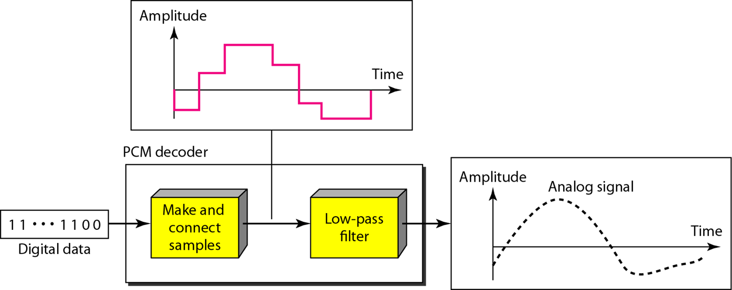
PCM Decoder
To recover an analog signal from a digitized signal we follow the following steps:
  We use a hold circuit that holds the amplitude value of a pulse till the next pulse arrives.
  We pass this signal through a low pass filter with a cutoff frequency that is equal to the highest frequency in the pre-sampled signal.
The higher the value of L, the less distorted a signal is recovered.
4.<number>

Slide 20

Delta Modulation
This scheme sends only the difference between pulses
If the pulse at time t_{n+1} is higher in amplitude value than the pulse at time t_{n}, then a single bit, say a “1”, is used to indicate the positive value.
If the pulse is lower in value, resulting in a negative value, a “0” is used.
This scheme works well for small changes in signal values between samples.
If changes in amplitude are large, this will result in large errors.
4.<number>

Slide 21

Figure 4.29 Delta modulation components
4.<number>

Slide 22

Figure 4.30 Delta demodulation components
4.<number>

Slide 23
Delta PCM (DPCM)
Instead of using one bit to indicate positive and negative differences, we can use more bits -> quantization of the difference.
Each bit code is used to represent the value of the difference.
The more bits the more levels -> the higher the accuracy.
4.<number>

Slide 24
4-3 TRANSMISSION MODES
The transmission of binary data across a link can be accomplished in either parallel or serial mode.
In parallel mode, multiple bits are sent with each clock tick.
In serial mode, 1 bit is sent with each clock tick.
serial transmission can be
  asynchronous,
  synchronous,
  isochronous.
4.<number>

Slide 25

Figure 4.31 Data transmission and modes
4.<number>

Slide 26

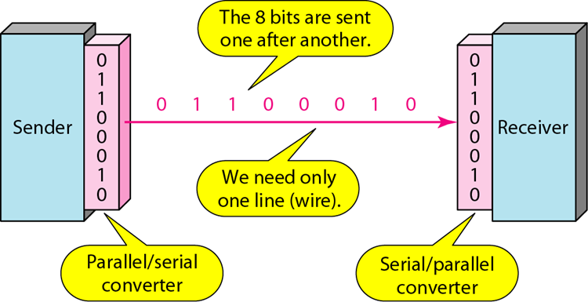
Parallel transmission
Serial transmission
4.<number>

Slide 27

Figure 4.34 Asynchronous transmission
In asynchronous transmission, we send 1 start bit (0) at the beginning and 1 or more stop bits (1s) at the end of each byte. There may be a gap between each byte.
Asynchronous here means “asynchronous at the byte level,”
but the bits are still synchronized; their durations are the same.
4.<number>

Slide 28

Figure 4.35 Synchronous transmission
In synchronous transmission, we send bits one after another without start or stop bits or gaps.
It is the responsibility of the receiver to group the bits.
The bits are usually sent as bytes and many bytes are grouped in a frame.
A frame is identified with a start and an end byte.
4.<number>

Slide 29
Isochronous
In isochronous transmission we cannot have uneven gaps between frames.
Transmission of bits is fixed with equal gaps.
4.<number>

